Slide 1
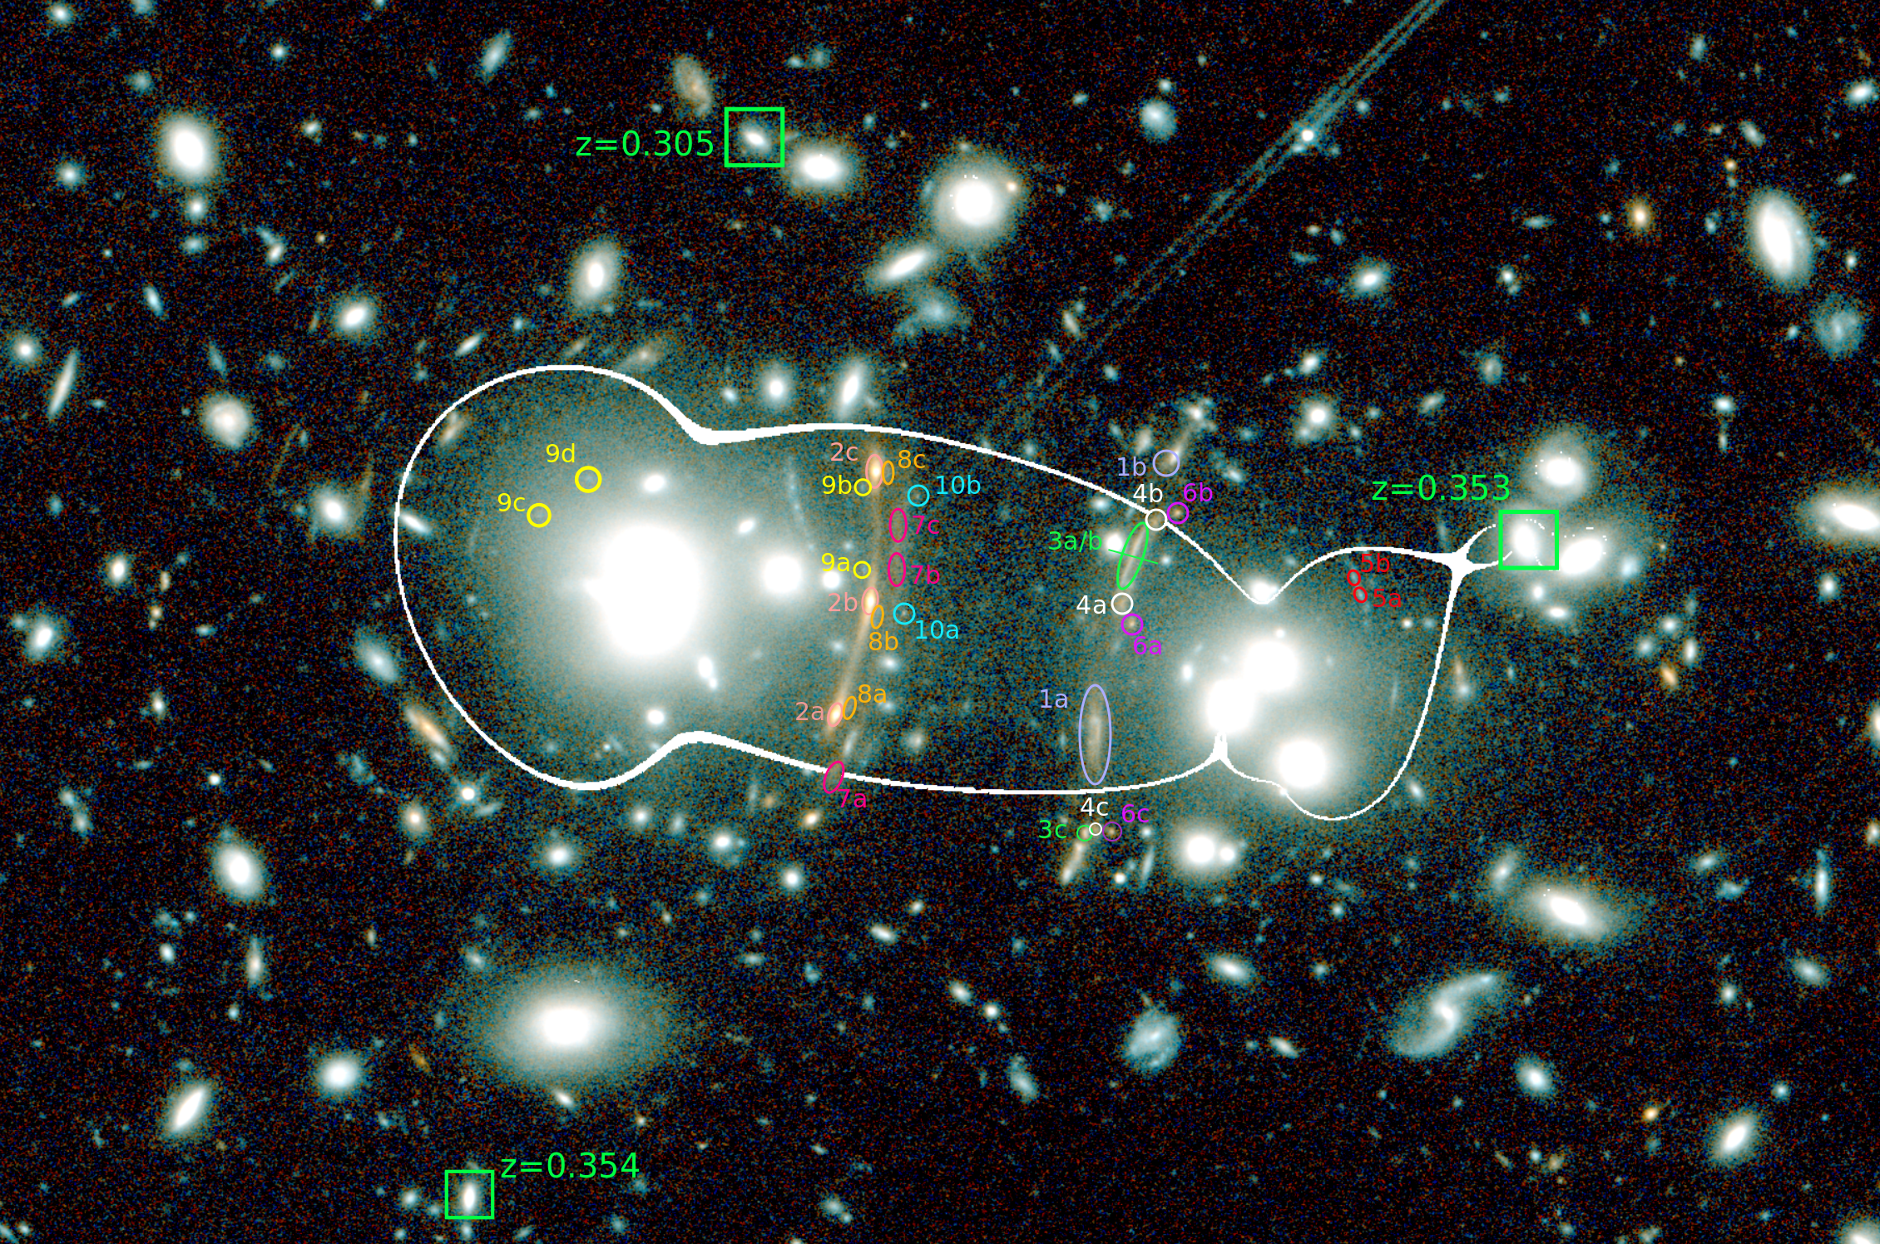
Characterization and Analysis of Massive Space Telescopes
Adam Bauer
PI: Dr. Brenda Frye
(Frye,…Bauer,…et al. 2018)

Slide 2
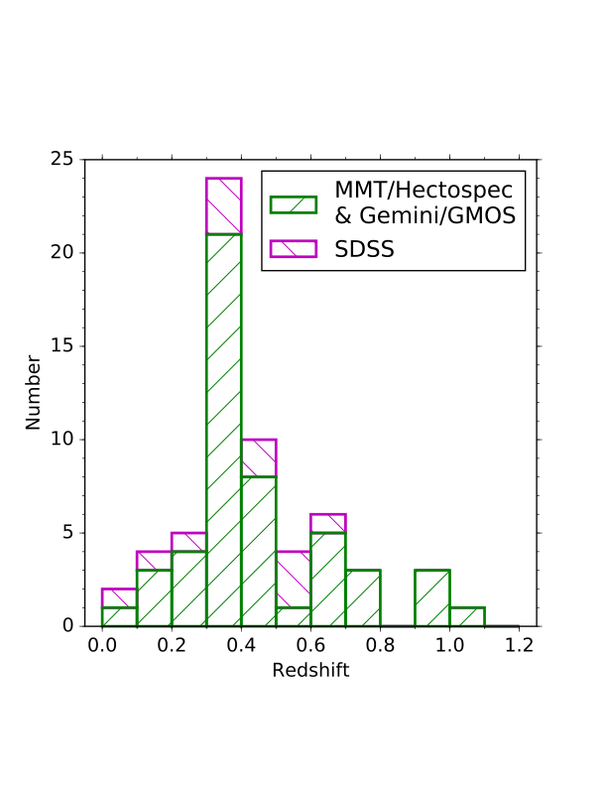
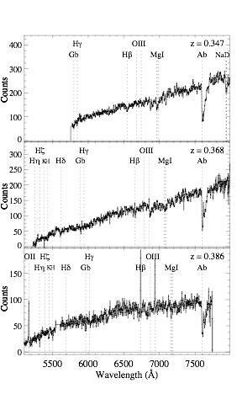
(Frye,…Bauer,…et al. 2018)

Slide 3
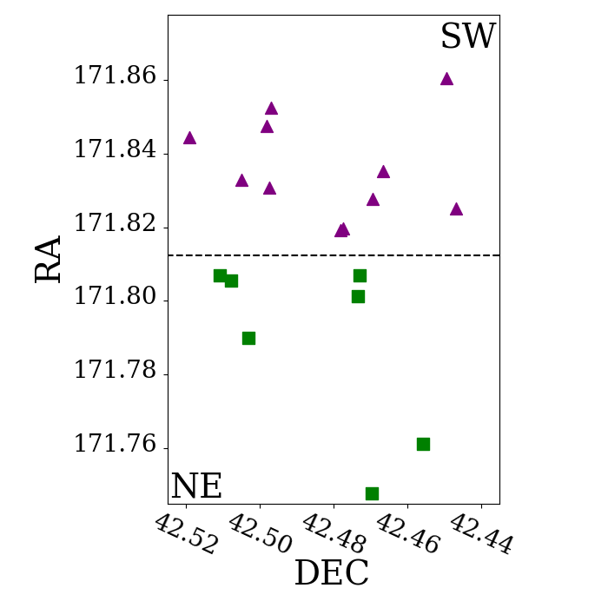
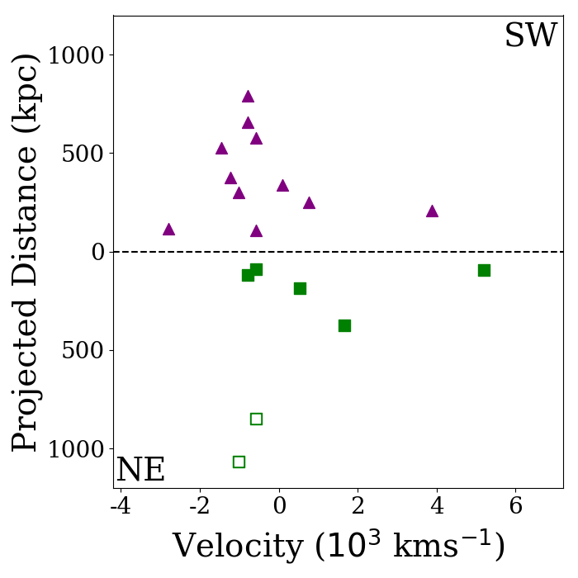
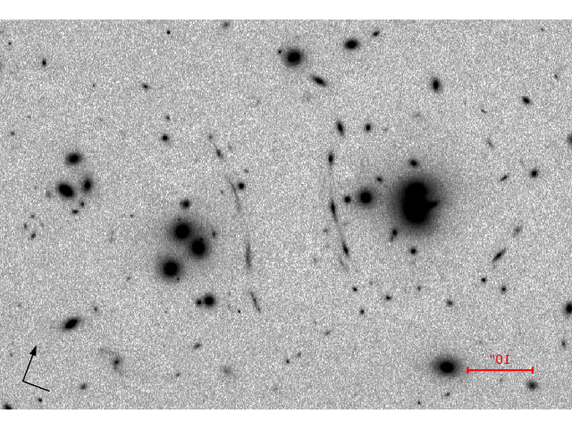
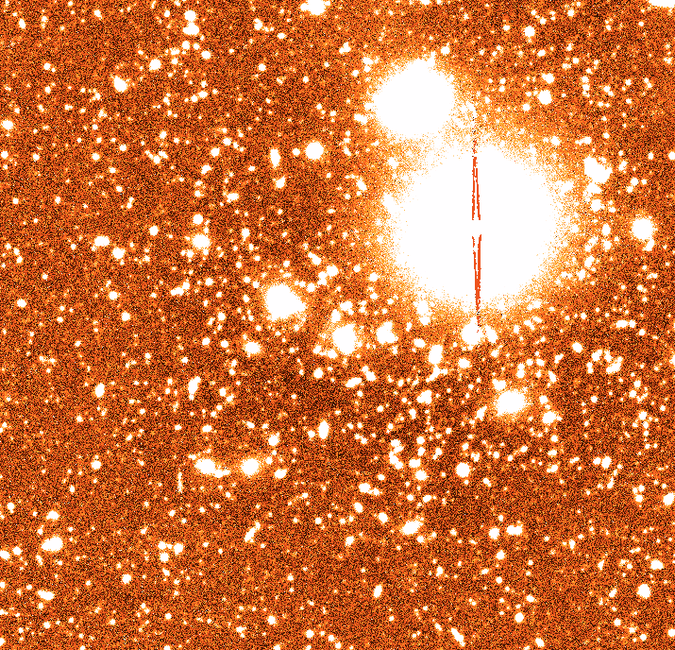
LBT Luci-ARGOS K
We draw a bifurcation line through the middle of the cluster and compute velocity with respect to the cluster redshift.
We find that the NE region is situated behind the SW region.
The hollow squares show emission lines and are likely infalling galaxies.
The next step: we will combine imaging from optical through IR to estimate photometric redshifts.
LBT/LBC g-band

Slide 4
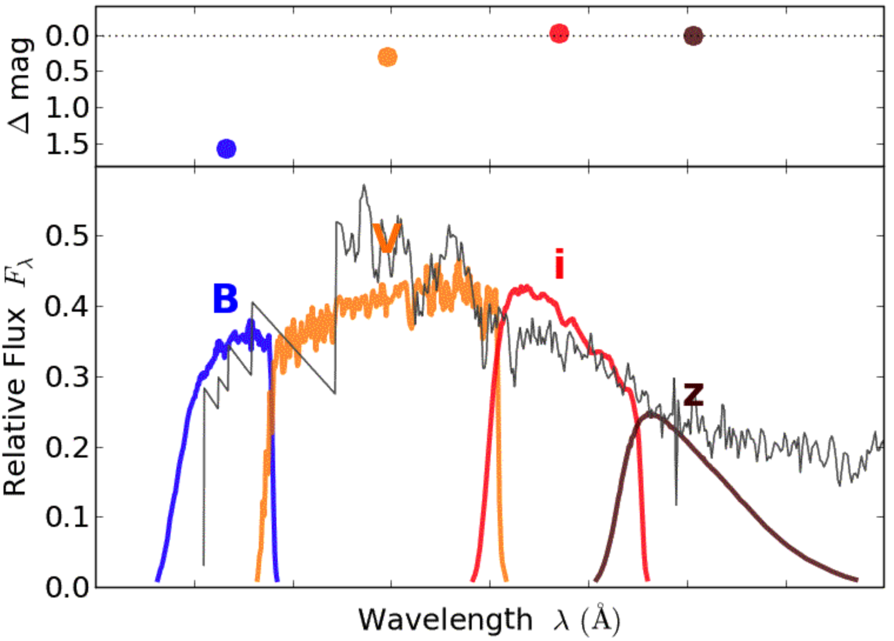
Photometric Redshift Estimation
For objects that are too dim to get spectroscopic redshifts, we rely on photometric redshifts.
Each photometric profile gives us a cluster of points at a specific band.
We fit the points to “templates” from objects of known redshift.
Using Bayesian interference, we update which “template” gives a best fit.
(Taken from stsci.edu)

Slide 5
Acknowledgements
UA/NASA Space Grant Consortium
Dr. Brenda Frye (UA)
Dr. Phil Pinto (UA)
Dr. Mischa Schirmer (Max Planck Institute for Astronomy)

